Slide 1
SS ZG653 (RL 8.1): Software Architecture Documenting Architecture with UML
Instructor: Prof. Santonu Sarkar
November 4, 2015

Slide 2
Unified Modeling Language (Introduction)
Modeling Language for specifying, Constructing, Visualizing and documenting software system and its components
Model -> Abstract Representation of the system [Simplified Representation of Reality]
UML supports two types of models:
- Static - Dynamic

Slide 3
UML
Unified Modeling Language is a standardized general purpose modeling language in the field of object oriented software engineering
The standard is managed, and was created by, the Object Management Group.
UML includes a set of graphic notation techniques to create visual models of object-oriented software-intensive systems

Slide 4
Documenting Architecture
UML has not been designed specifically for architecture, though practitioners use UML for architecture description
It is upto the architect to augment UML for architecture
UML provides no direct support for module-structure, component-connector structure or allocation structure

Slide 5
Three Structures- Recap
Module Structure
Code units grouped into modules
Decomposition
Larger modules decomposed into smaller modules
Use
One module uses functionality of another module
Layered
Careful control of uses relation

Slide 6
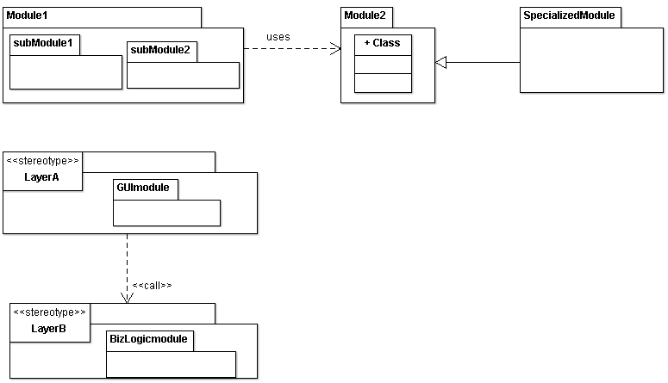
Illustration- Module Views
Decomposition
Packages are used as modules
Other approaches
One can use class, or interface to denote a module
Relations
One can use various other UML relations to denote uses, layering or generalization
Layering

Slide 7
Three Structures- Recap
Component-Connector Structure
Processes
Components are processes and relations are communications among them
Concurrency
Relationships between components- control flow dependency, and parallelism
Client-Server
Components are clients or servers, connectors are protocols
Shared data
Components have data store, and connectors describe how data is created, stored, retrieved

Slide 8
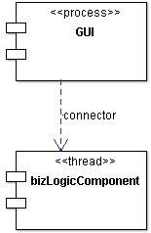
Illustration- CNC Views
No standard representation exists
UML components are used with stereotypes
Other approaches
One can use class, interface, or package to denote a component
Relations
One can use various other UML relations such as association class
Component

Slide 9
Three Structures- Recap
Allocation Structure
Deployment
Units are software (processes from component-connector) and hardware processors
Relation means how a software is allocated or migrated to a hardware
Implementation
Units are modules (from module view) and connectors denote how they are mapped to files, folders
Work assignment
Assigns responsibility for implementing and integrating the modules to people or team

Slide 10
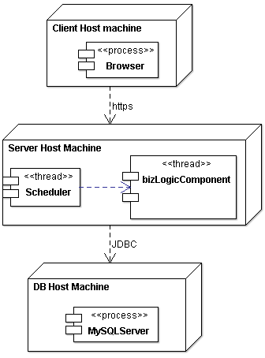
Illustration-Allocation Views
UML Deployment diagram is a good option for deployment structure
No specific recommendation for work assignment and implementation
Comes from CNC view

Slide 11
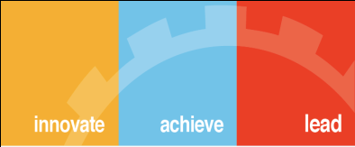
Thank You

